Slide 1




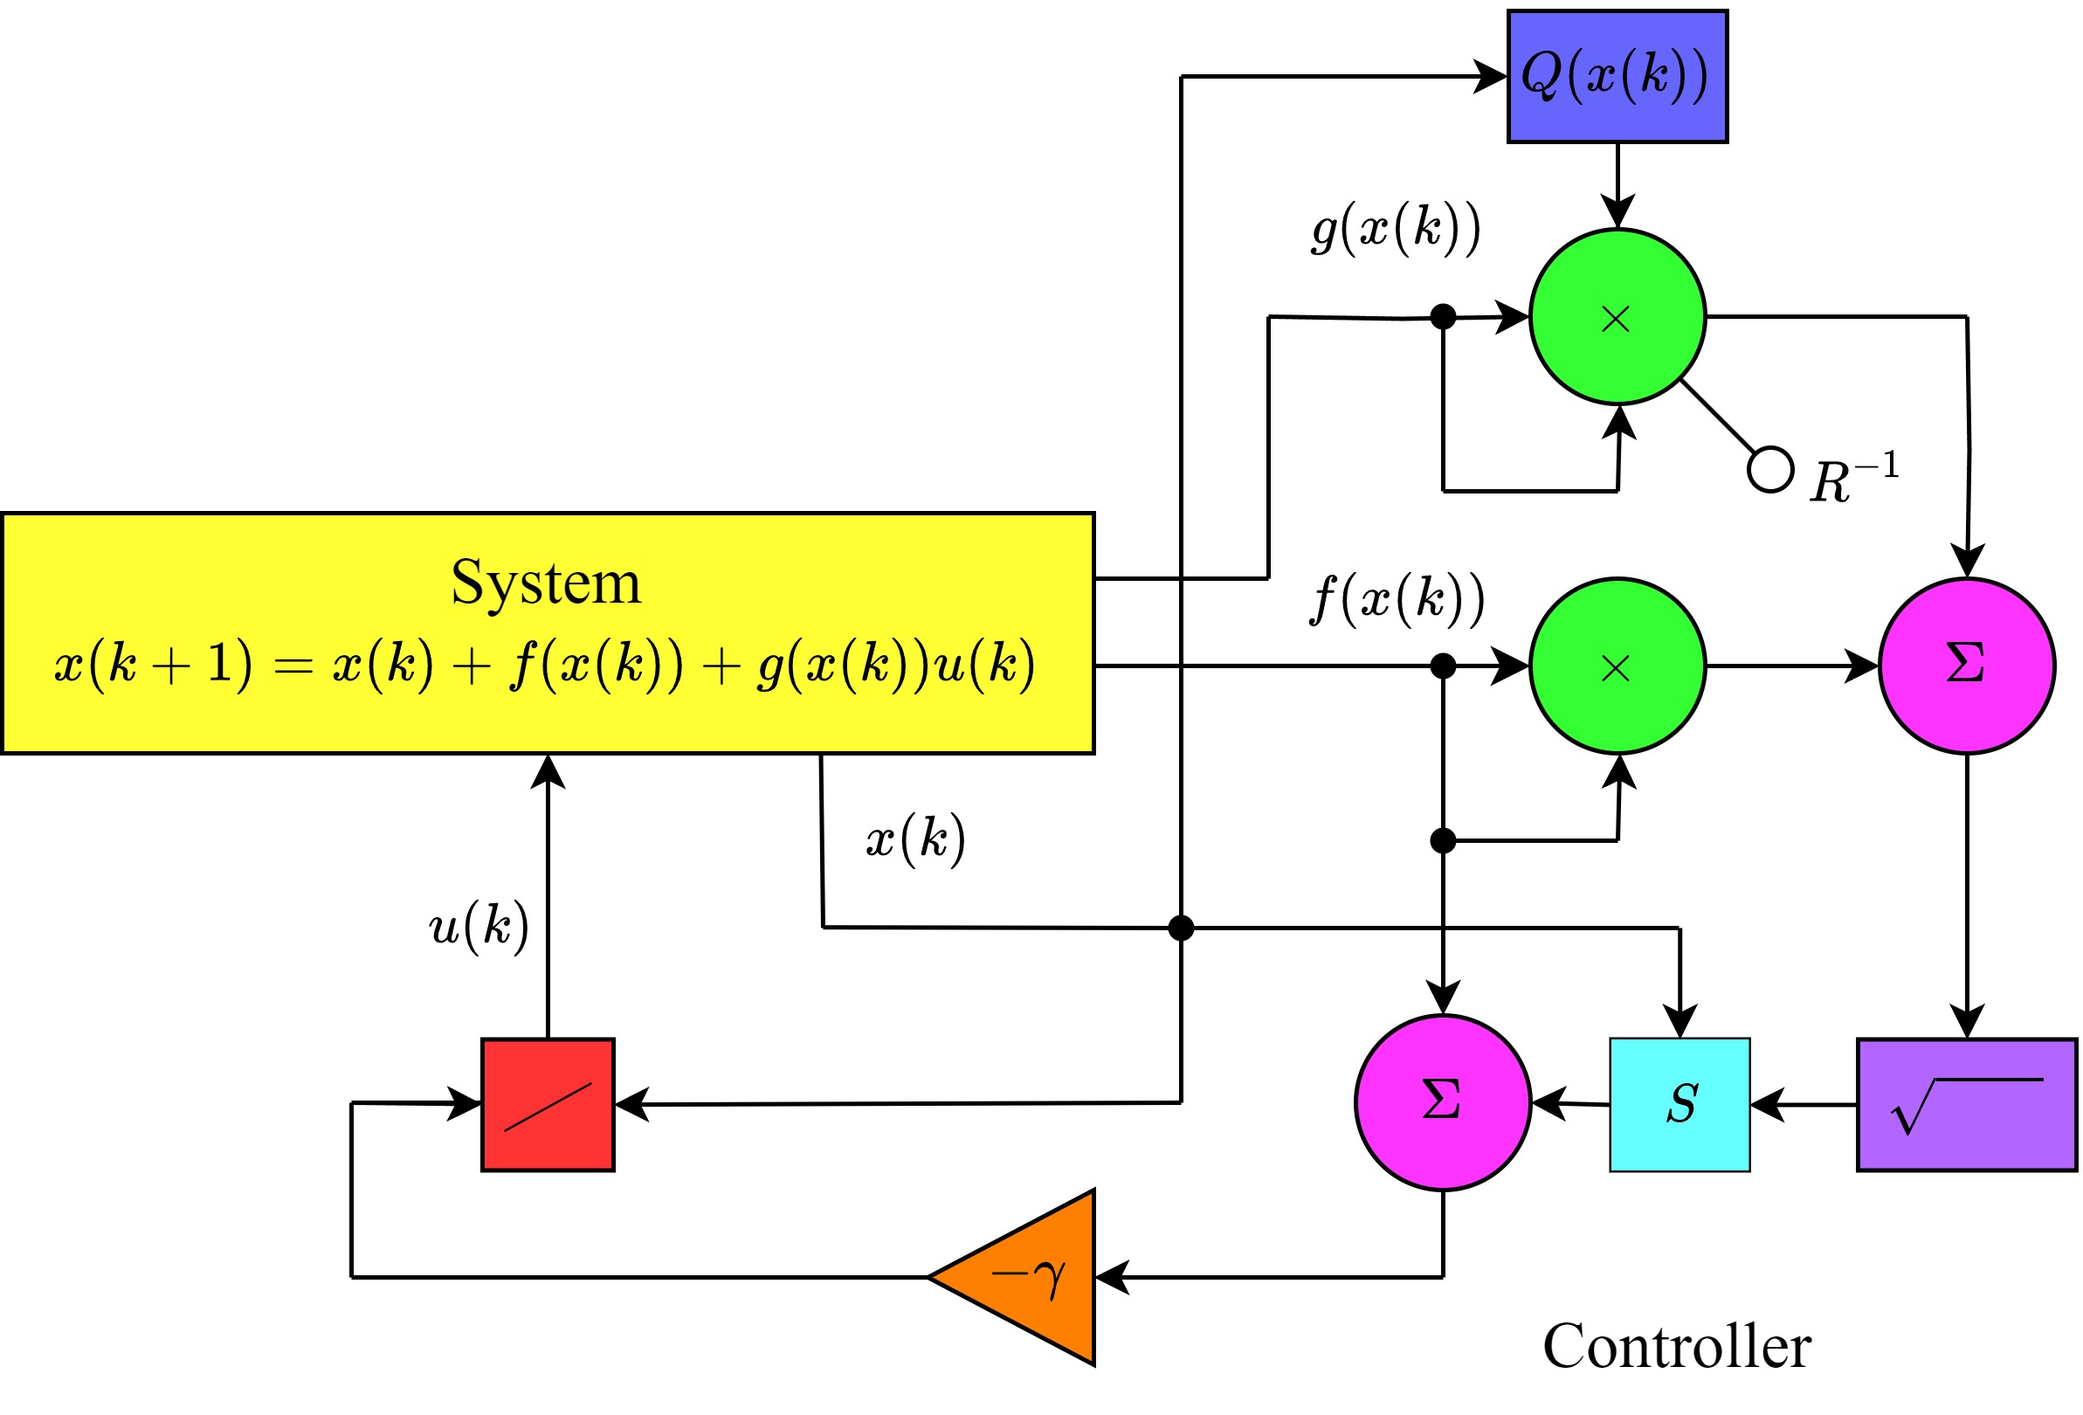
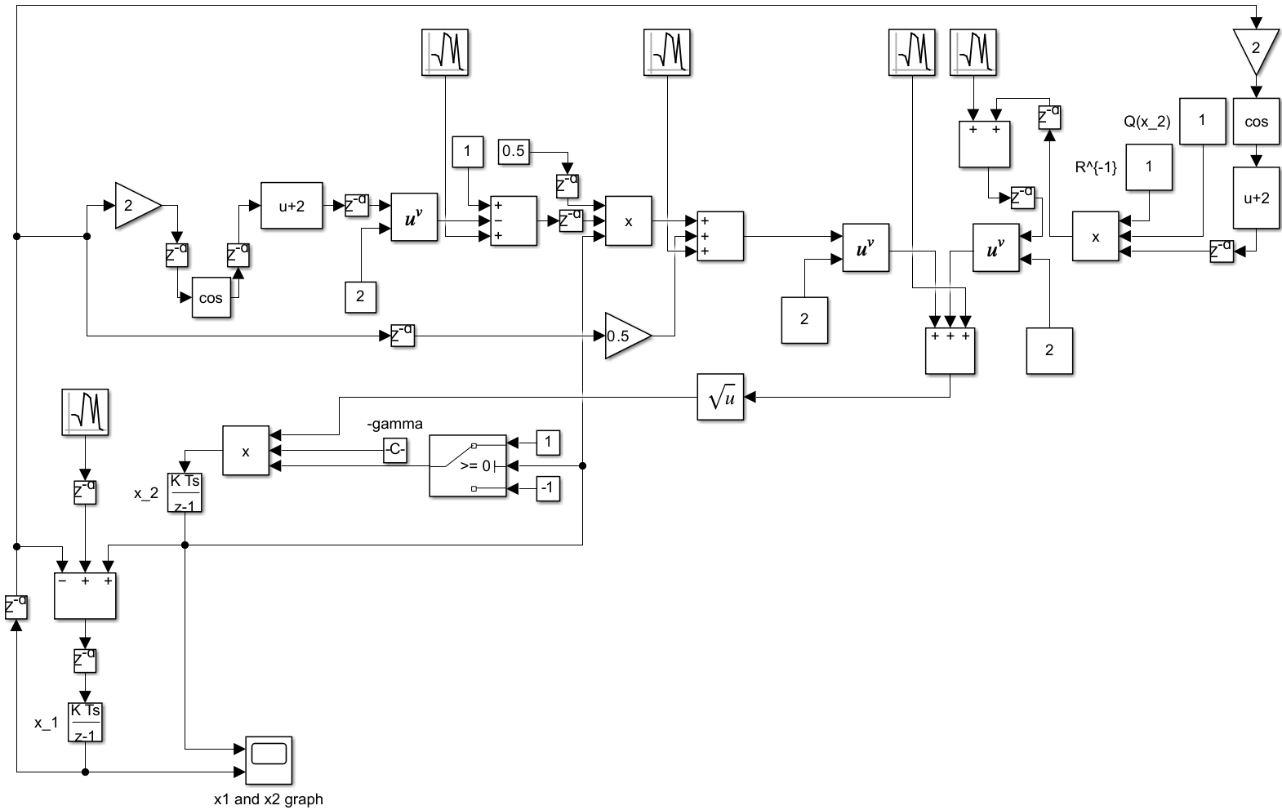
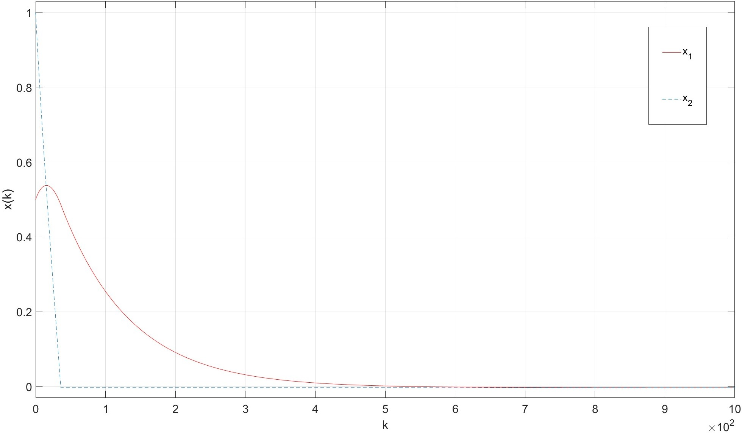
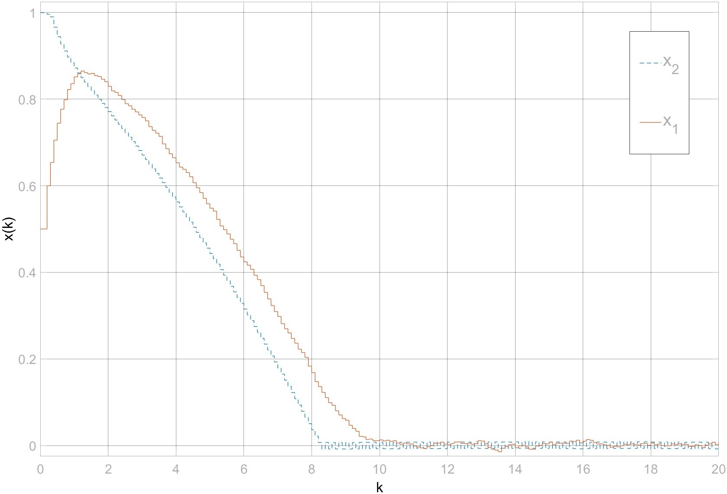
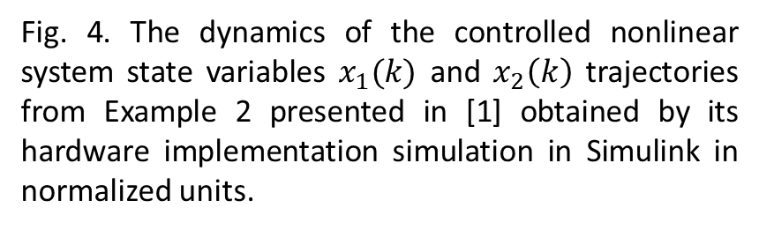
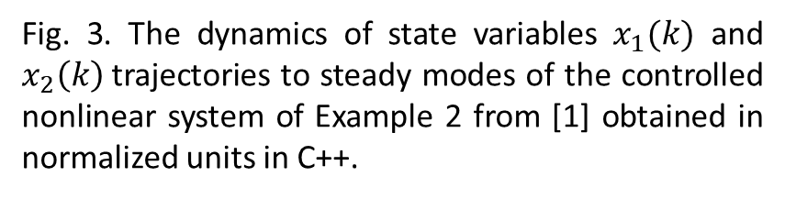
Optimal Control Discrete-Time Neural Network for Nonlinear Systems with Known Dynamics
Daniel Castaneda, University of California, Riverside
Pavlo Tymoshchuk, University of North Texas
dcast162@ucr.edu; Pavlo.Tymoshchuk@unt.edu
Abstract
An optimal control discrete-time neural network for affine in the inputs nonlinear systems with the known dynamics has been designed. The network is described by a system of difference equations with variable structure. The control is derived analytically. A functional block-diagram of the network is constructed. The network does not require any training and is of moderate complexity. It is shown that the discrete-time state-variable trajectories of the network are globally asymptotically stable and globally asymptotically convergent to steady states. Computer simulations confirming theoretical results and illustrating a performance of the network are provided using MATLAB, Simulink and C++.
Introduction
Results
Optimal control provides generating the best possible output of the system relatively to the assigned criterion that maximizes the system performance. Optimal control problems are solved by using a Pontryagin minimum principle that gives a necessary condition for optimality or by determining a solution of the Hamilton-Jacobi-Bellman (HJB) equation, which is a sufficient condition. In the general case, the HJB equation is a nonlinear differential equation that does not have an analytical solution in multidimensional case. Therefore, the solution of optimal control problem is usually derived by numerical approaches.
The operational errors of system implementation in MATLAB and C++ are close to zero in steady-state modes. In transient modes, the difference between these errors is ranged from zero to 100%.
Computer simulations confirm results of theoretical derivations according to which number of time steps for convergence of state variable trajectories to steady-state modes of the system decreases with increasing a value of parameter γ. In particular, the state variable trajectories of the system converge to steady modes in 12 time steps for γ=0.05.
According to the hardware implementation simulations, small changes of system parameters do not lead to large changes of state variables, and thus the system is not sensitive and is stable. In particular, a ±0.25 change in system parameters has around a difference of 0.20 in the output.
The elapsed time of the optimal control nonlinear system state variable trajectories to steady modes is equal to 23.101 ms in MATLAB and 0.22634 ms in C++. This means that the system implemented in C++ is in two order faster comparatively to one implemented in MATLAB.
Fig. 1. The functional block-diagram of one-dimensional controlled nonlinear system with known dynamics described by difference equation corresponding the differential equation presented in [1].
Fig. 2. The functional block-diagram of hardware implementation simulation in Simulink environment of controlled nonlinear system of Example 2 from [1] with added random noise and time delays.
Methodology
A functional block-diagram of the optimal control discrete-time neural network for nonlinear systems with knowns dynamics is designed on the basis of difference equation corresponding the differential equation presented in [1].
The discrete-time neural network is simulated in MATLAB, Simulink and C++. Accuracy and elapsed time obtained by these simulations are compared.
Stability and convergence of state-variable trajectories of the network to steady modes, its operation accuracy and speed depending on value of parameter γ are investigated by the computer simulations.
In order to simulate operation errors of inputs and inaccuracies of functional block-diagram parts, additive uniformly distributed random noise and time delays are applied. In particular, the random noise of Gaussian distribution with mean equal to 0.005 and variance equal to 0.001 is employed. Moreover, 11 delay units with delays equal to 1 sample each are added to the functional block-diagram parts.
Future Work
Future work is related to hardware implementation simulation of the optimal control discrete-time neural network for nonlinear systems with known dynamics in Cadence and/or LabVIEW and/or Arduino.
Fig. 3. The dynamics of state variables $x_{1}(k)$ and $x_{2}\left(k\right)$trajectories to steady modes of the controlled nonlinear system of Example 2 from [1] obtained in normalized units in C++.
Fig. 4. The dynamics of the controlled nonlinear system state variables $x_{1}(k)$ and $x_{2}\left(k\right)$ trajectories from Example 2 presented in [1] obtained by its hardware implementation simulation in Simulink in normalized units.
References
[1] P. Tymoshchuk, “Optimal control for continuous-time scalar nonlinear systems with known dynamics”, in Proc. 16th Int. Conf. Control, Automation, Robotics and Vision, Shenzhen, China, 2020, pp. 695–700.
Acknowledgements
This material is based upon work supported by the National Science Foundation under Grant number CNS-2137791. Any opinions, findings, and conclusions or recommendations expressed in this material are those of the authors and do not necessarily reflect the views of the National Science Foundation.

